Slide 1
Operating System

Slide 2
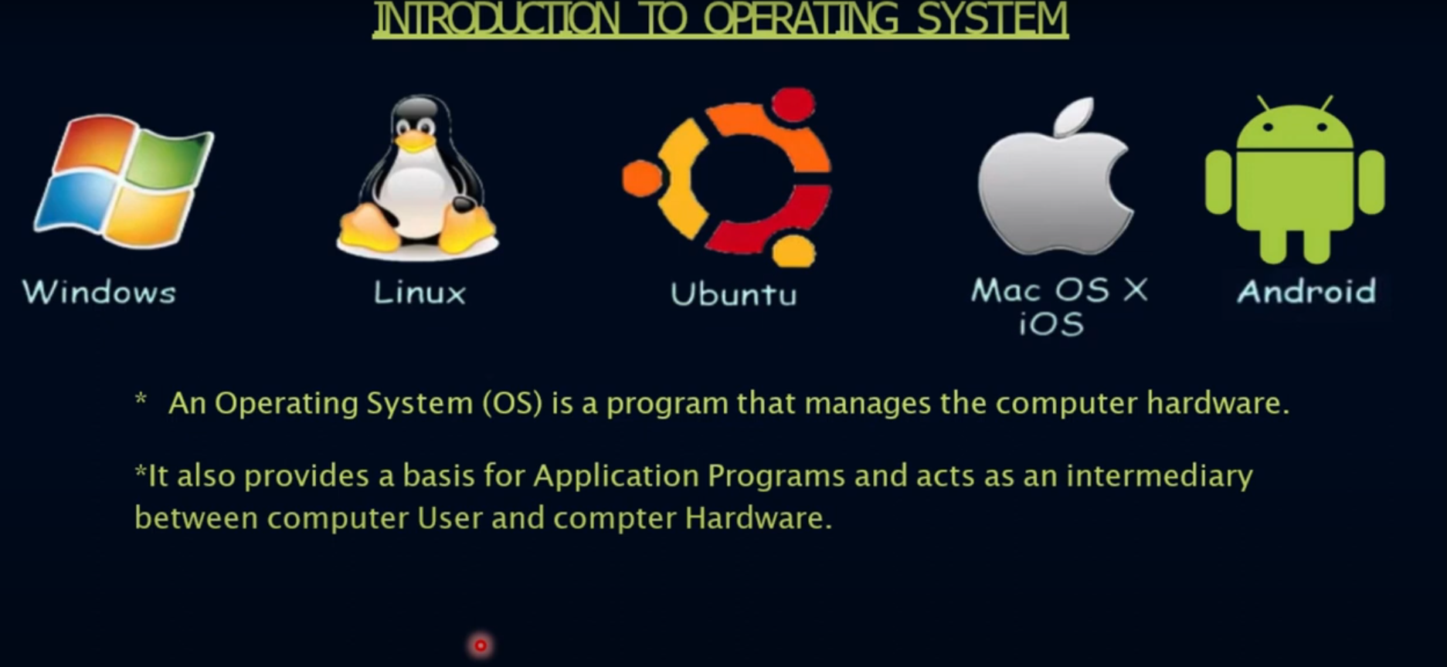

Slide 3
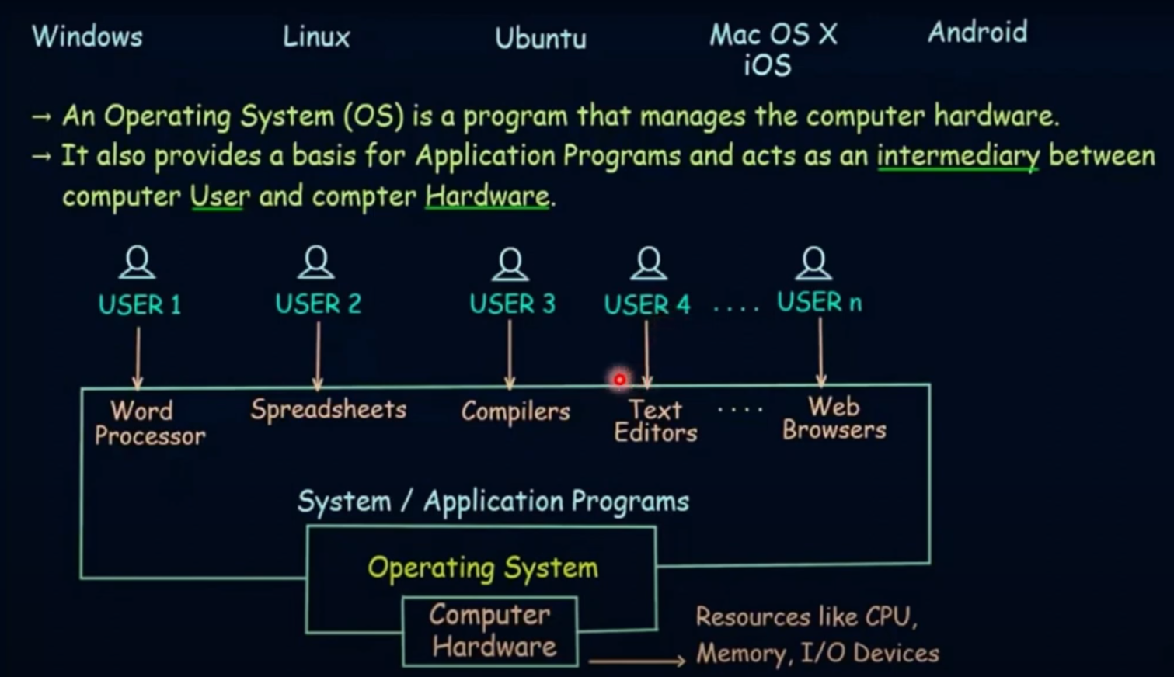

Slide 4
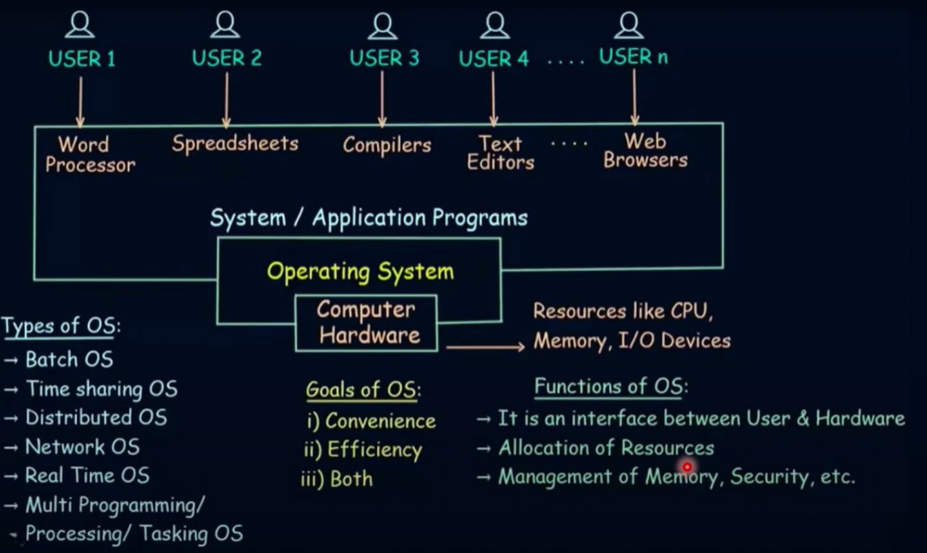

Slide 5
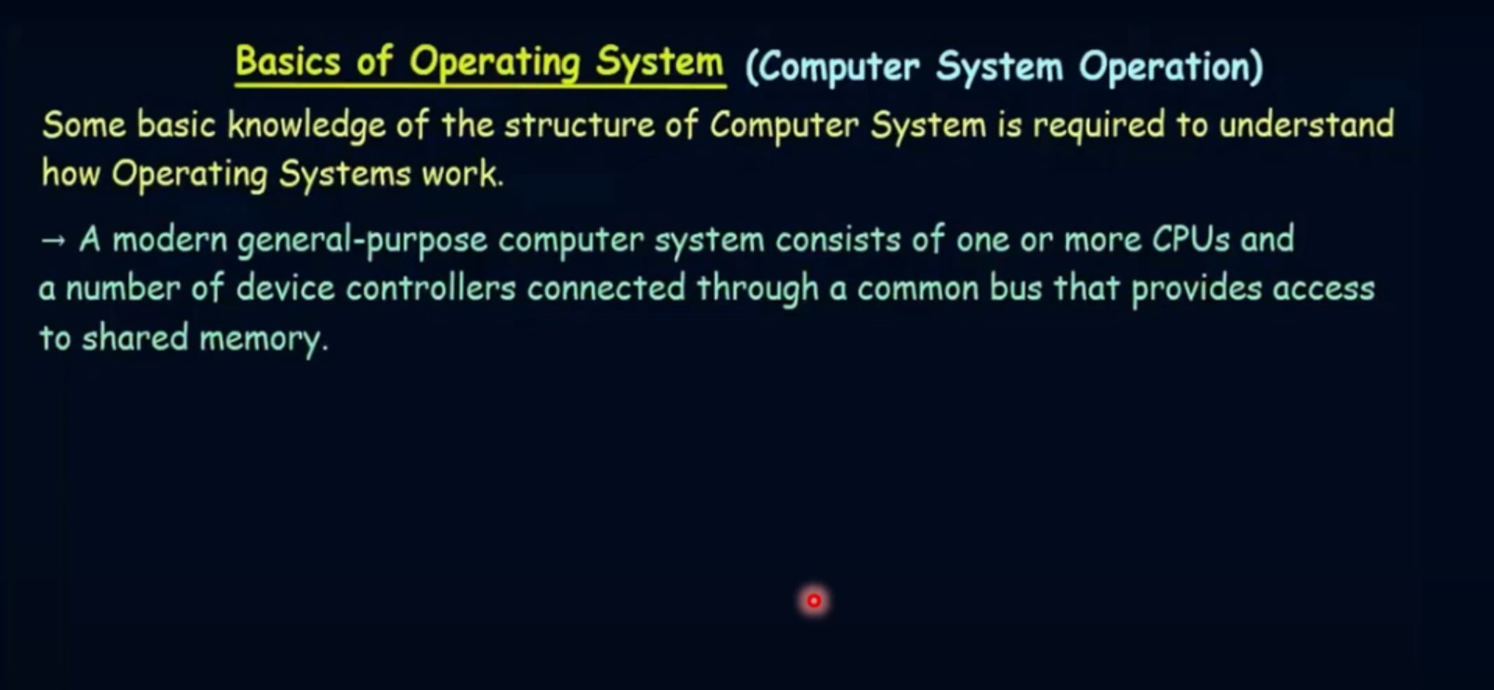

Slide 6
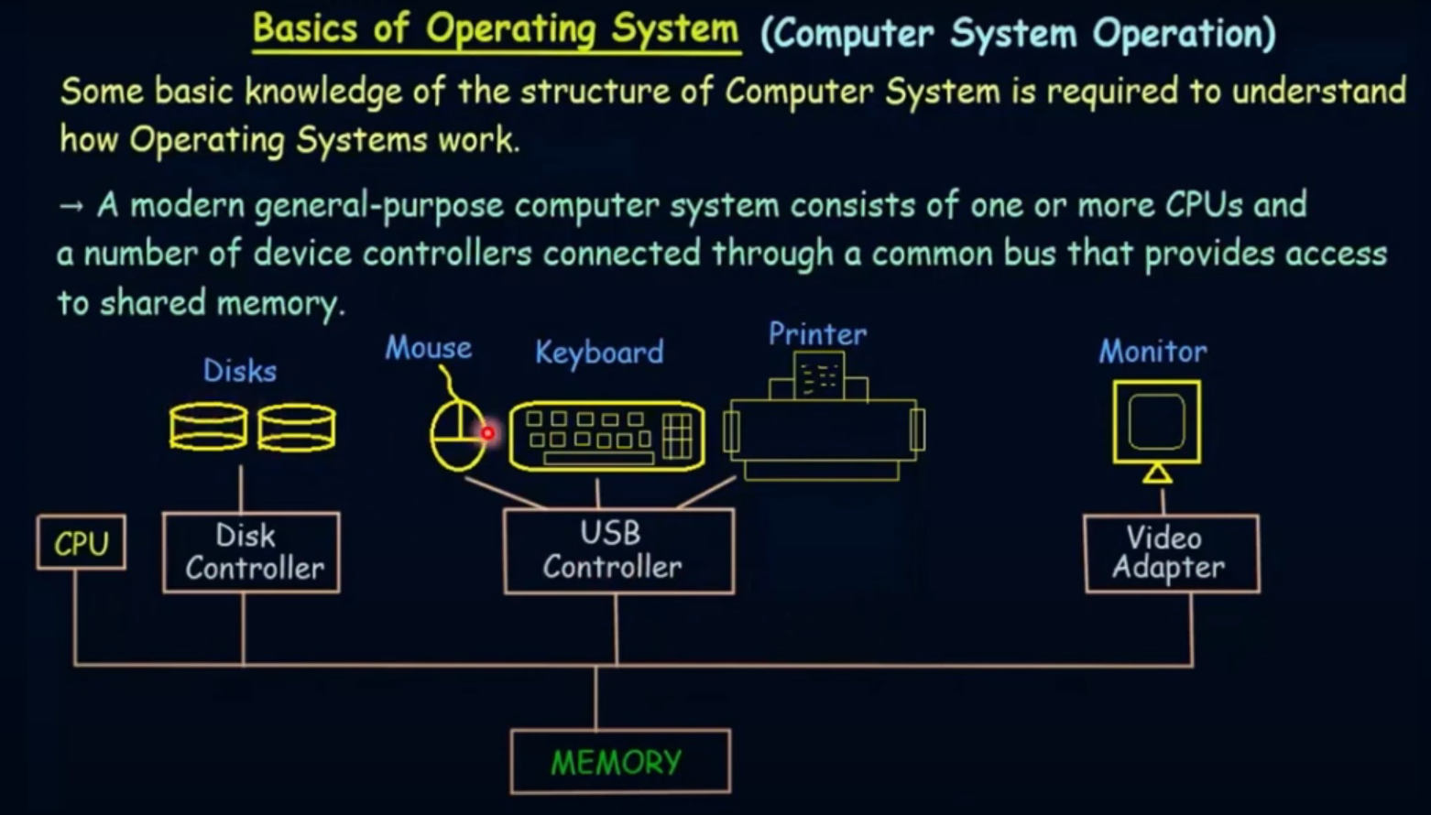

Slide 7
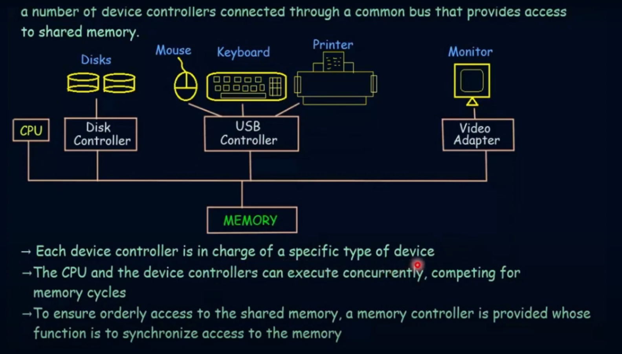

Slide 8
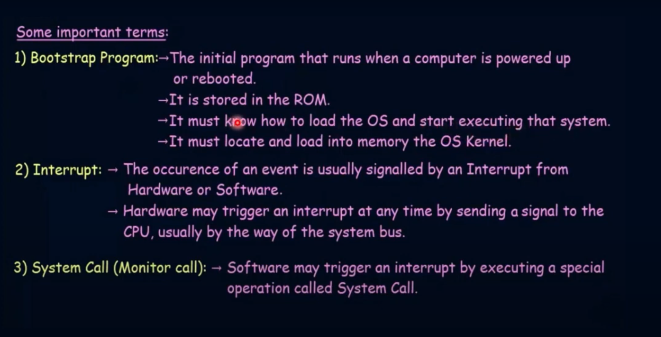

Slide 9
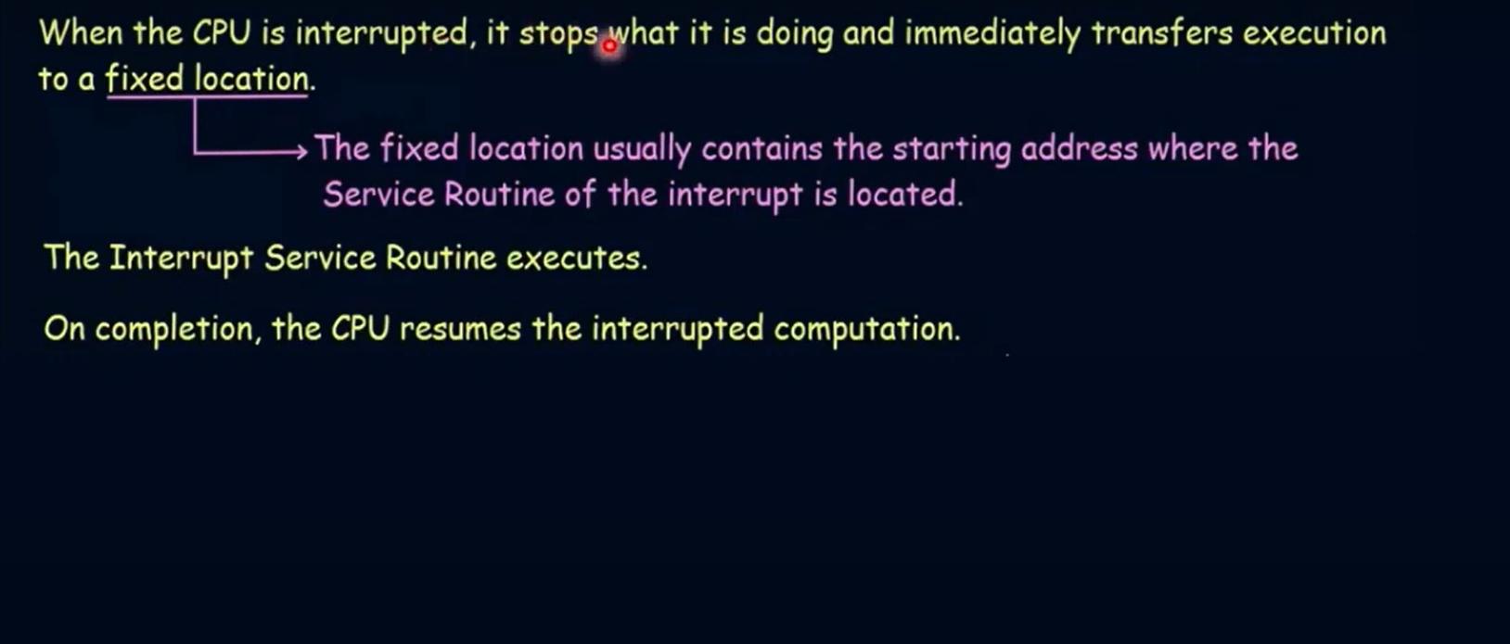

Slide 10
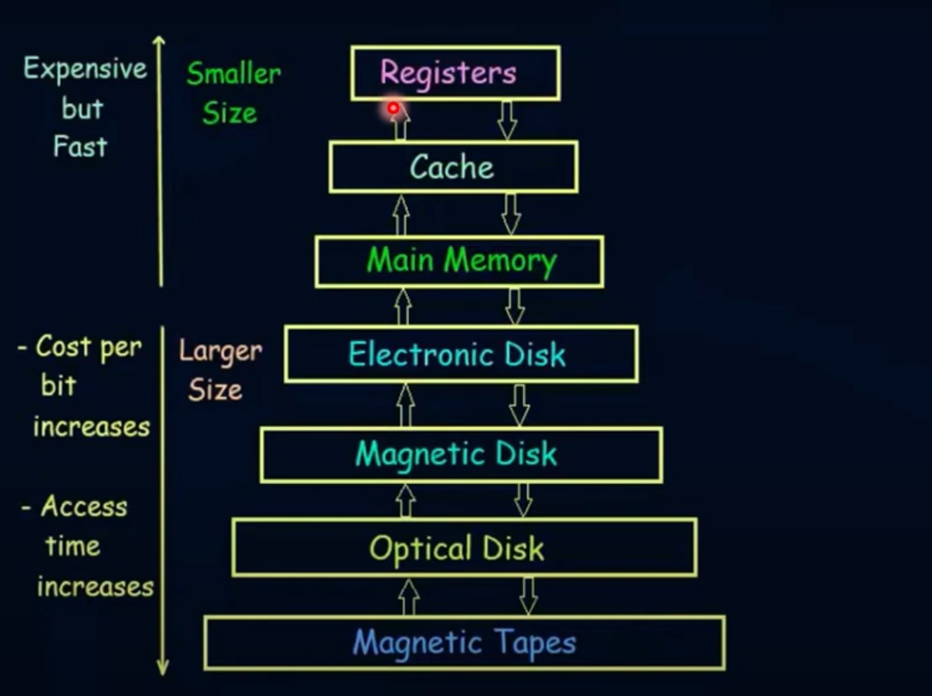
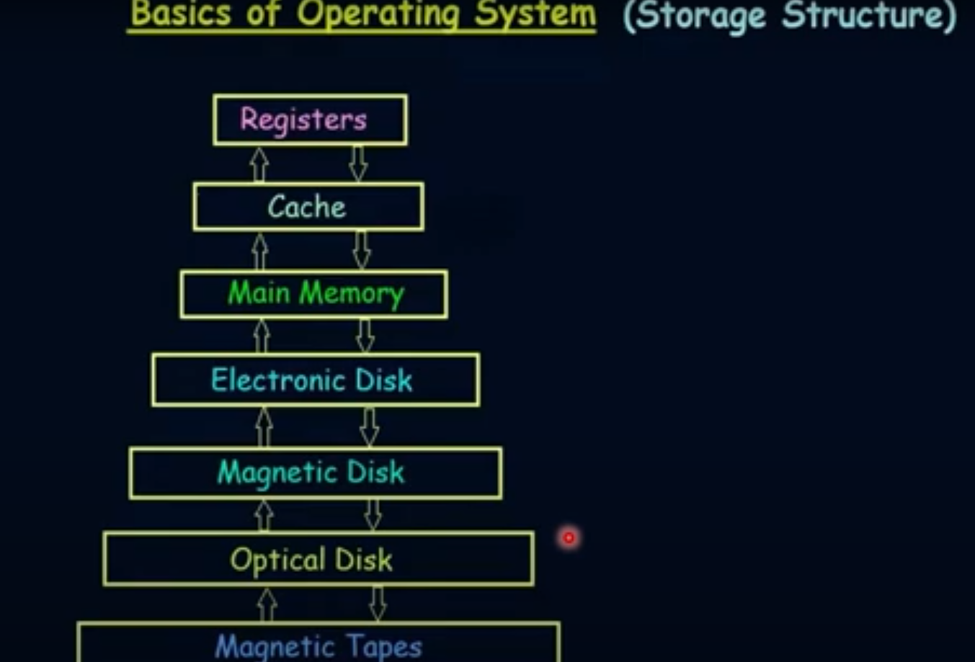

Slide 11
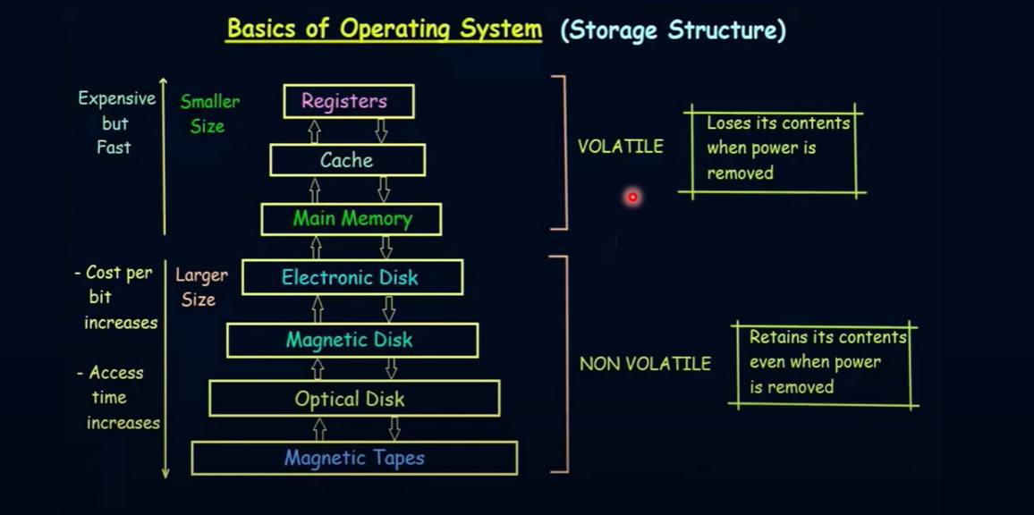

Slide 12
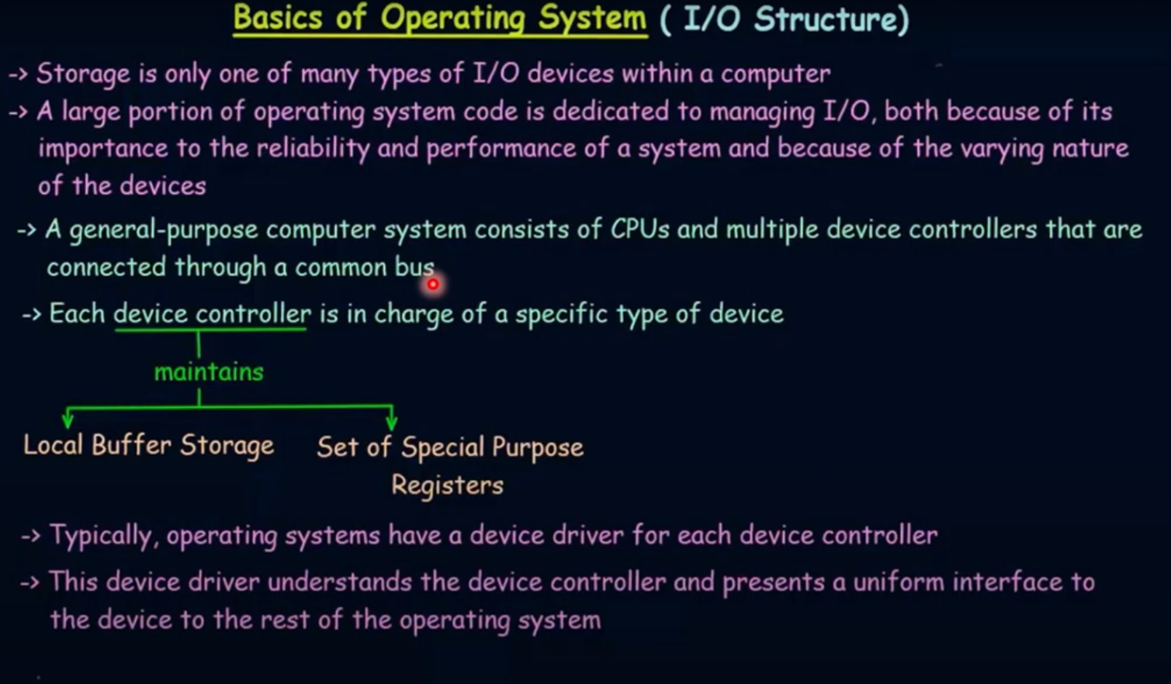

Slide 14
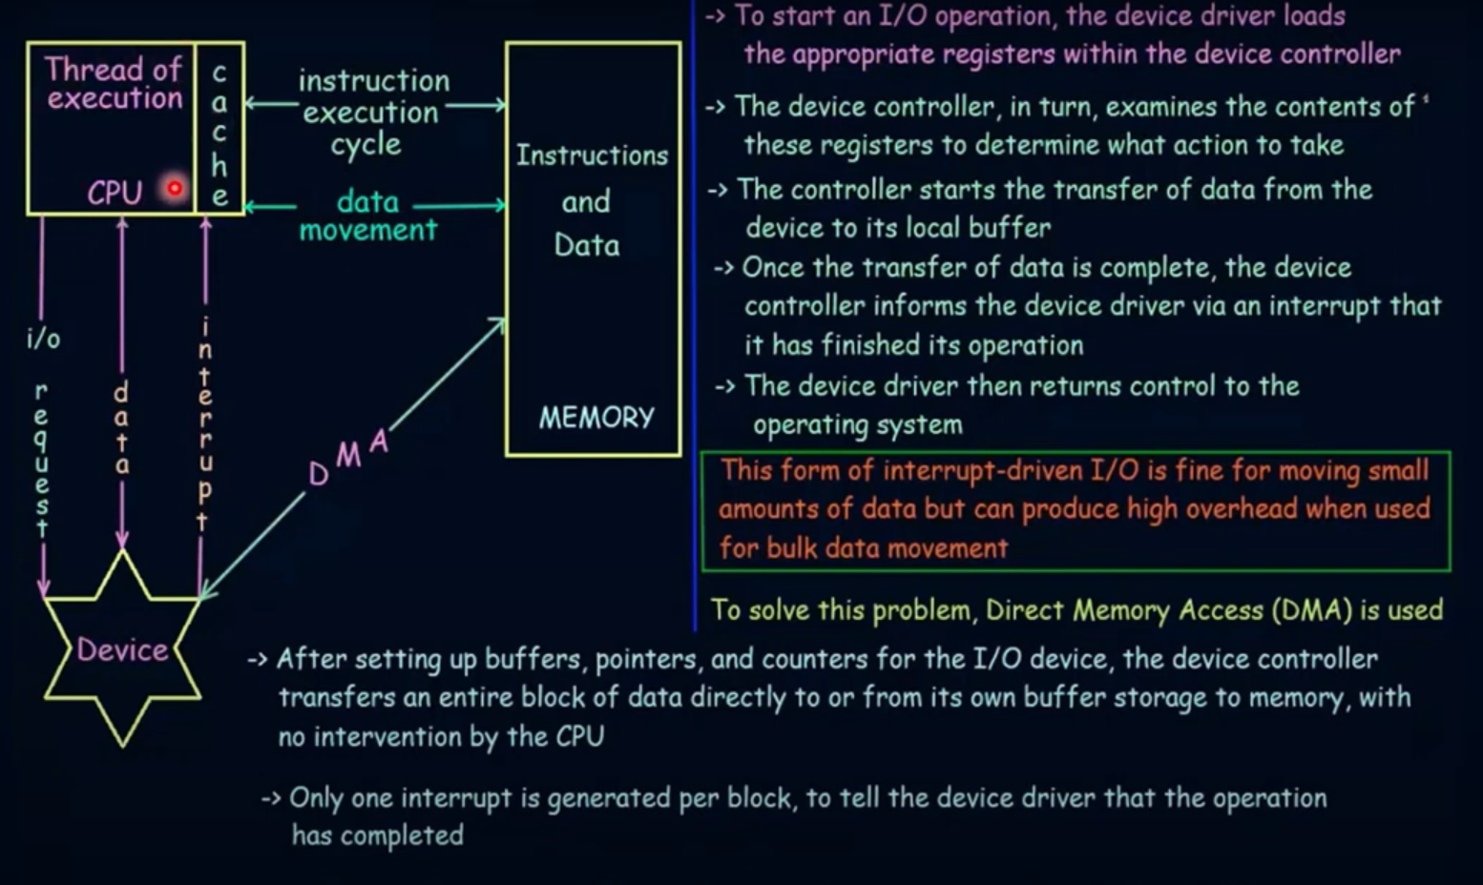

Slide 15
COMPUTER SYSTEM ARCHITECTURE

Slide 16
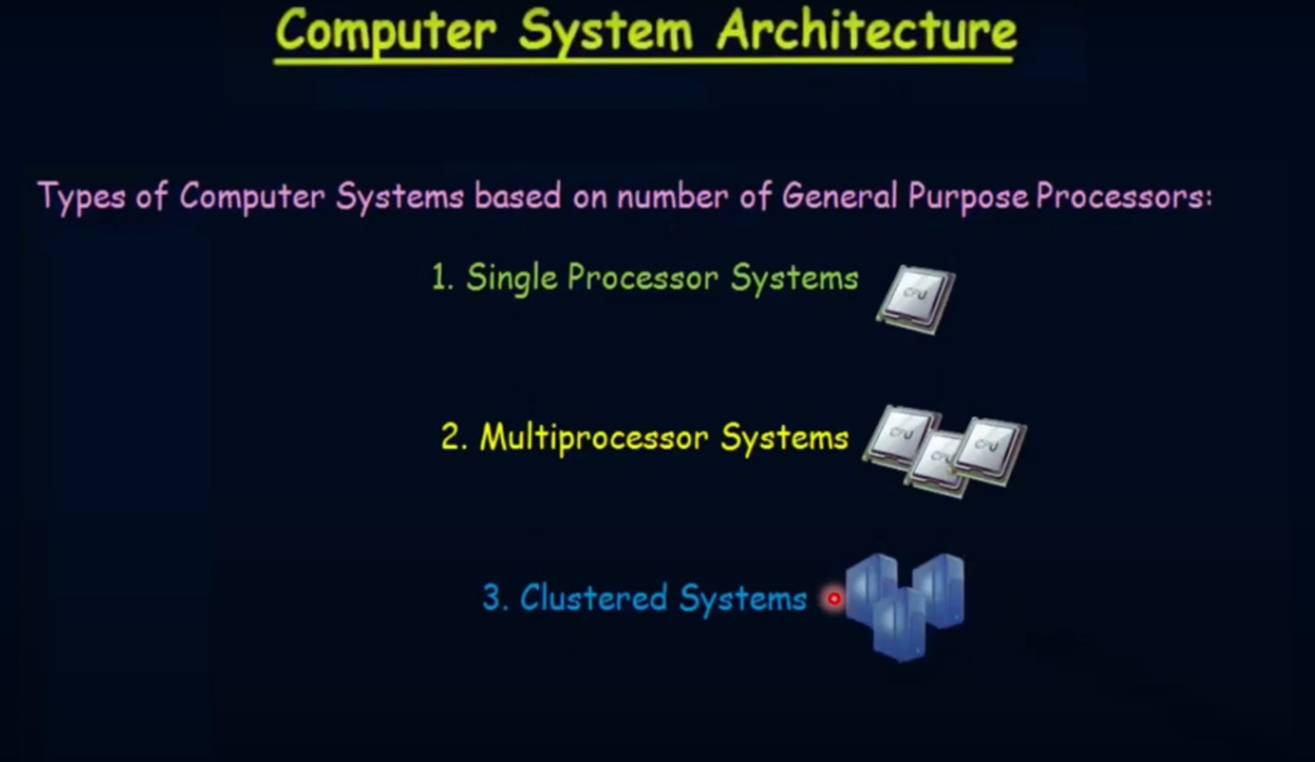

Slide 17
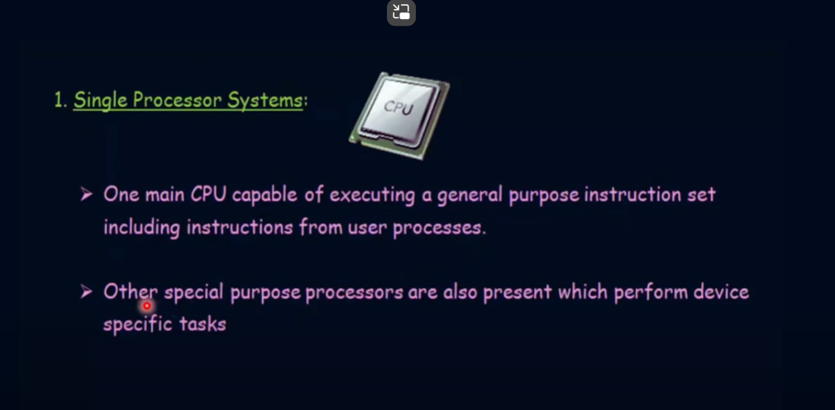

Slide 18
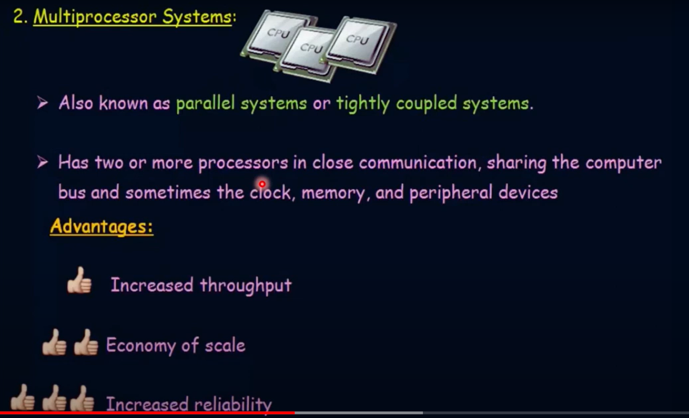

Slide 19
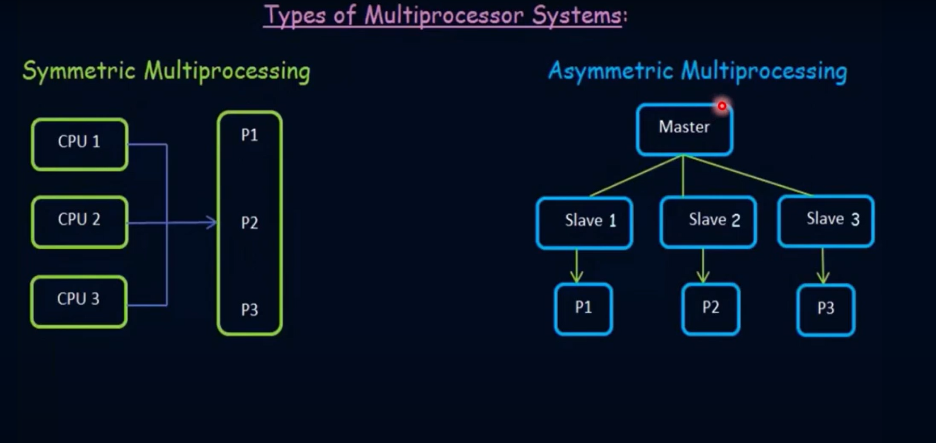

Slide 20
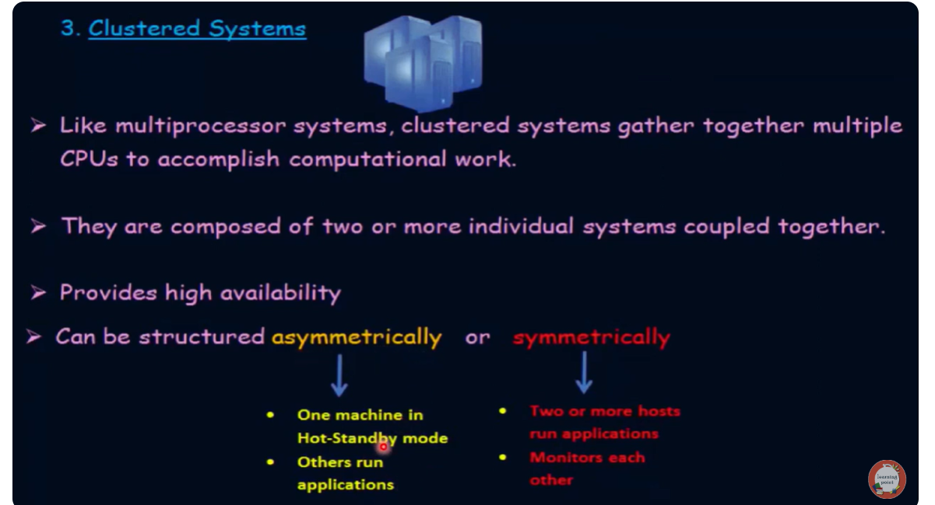

Slide 21
Operating System Structure

Slide 22
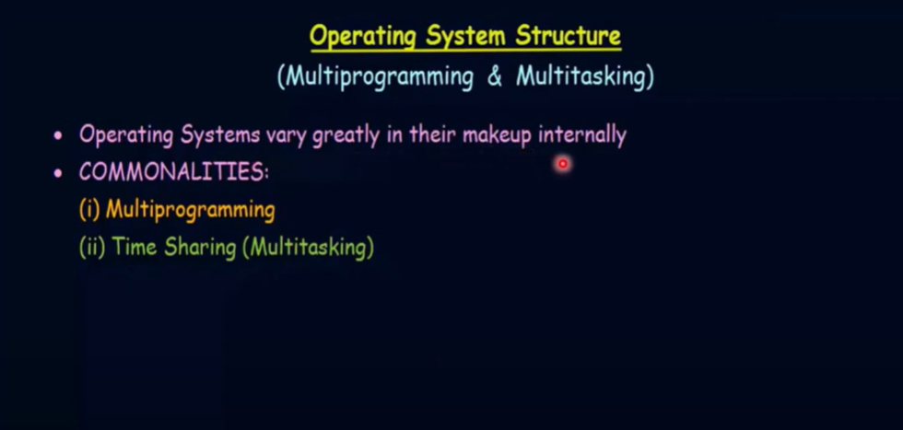

Slide 23
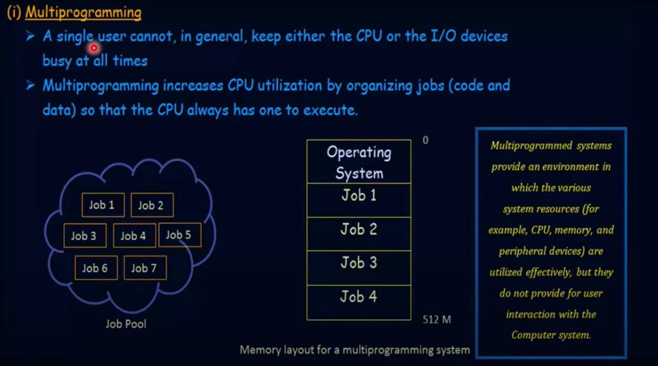

Slide 24
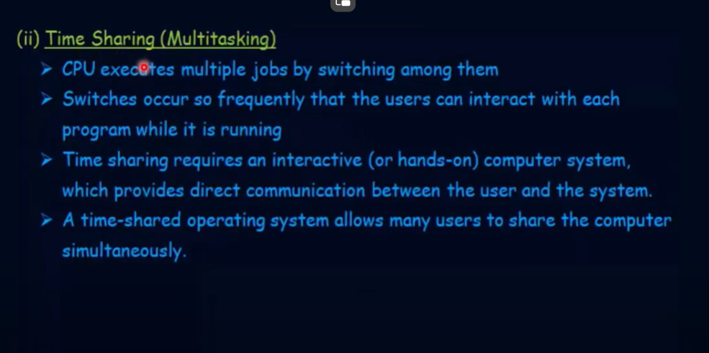

Slide 25
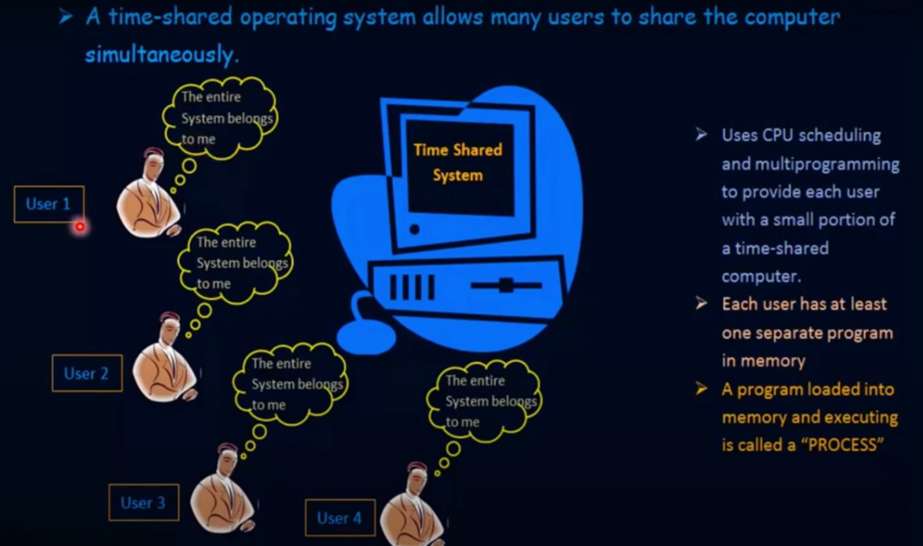

Slide 26
Operating System Services

Slide 27
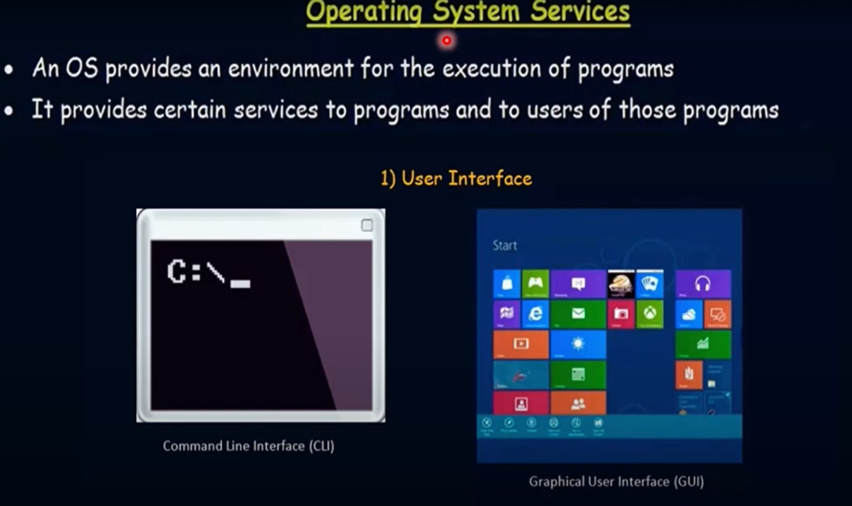

Slide 28
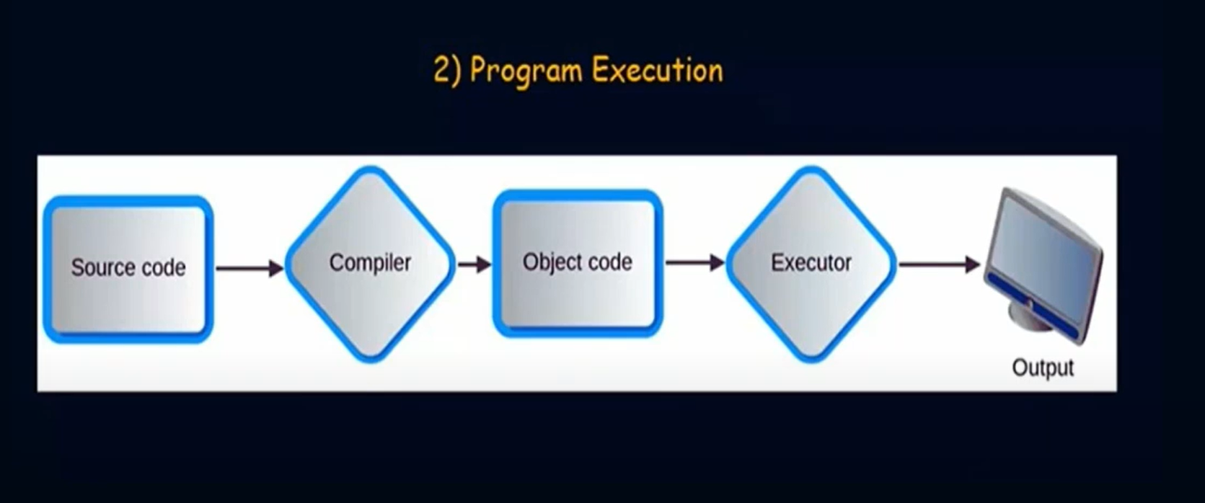

Slide 29
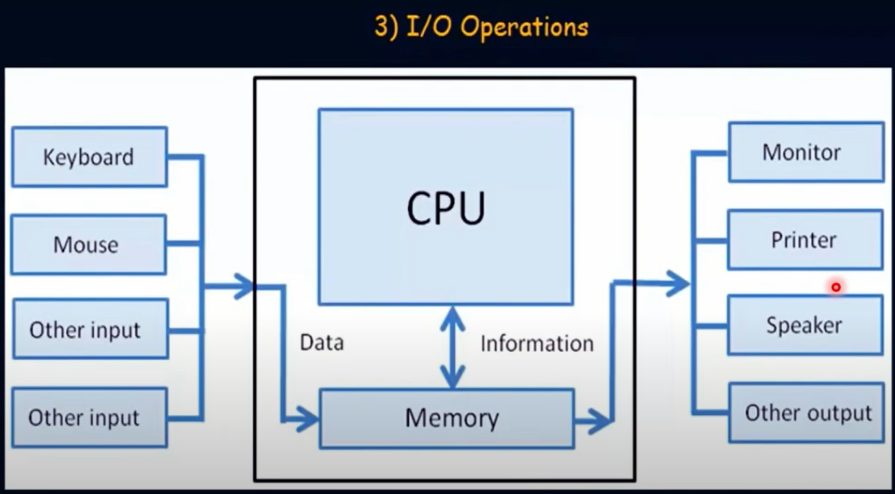

Slide 30
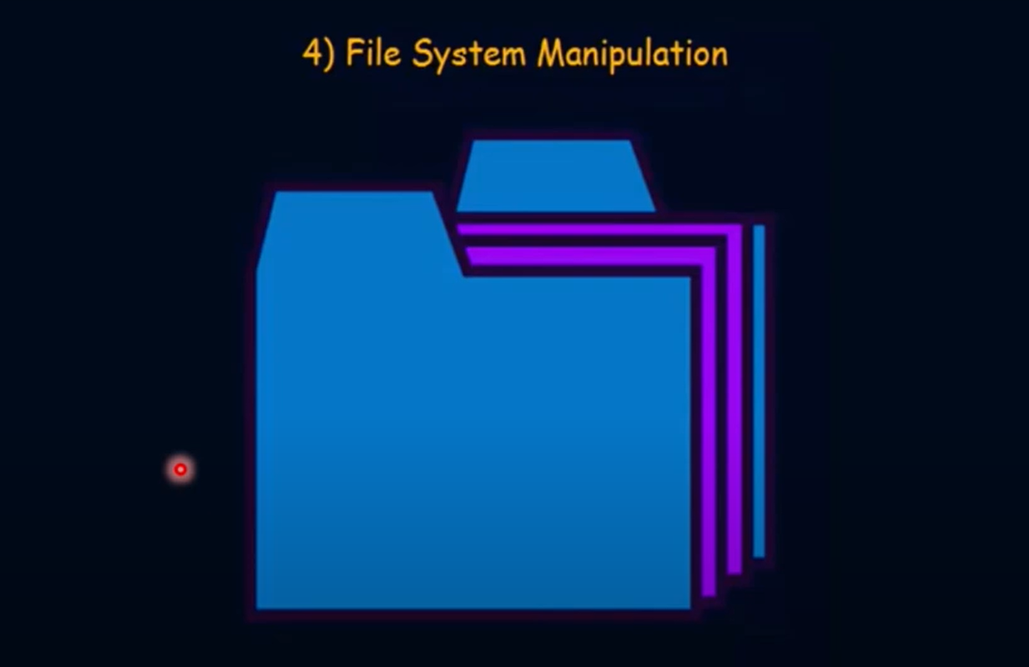

Slide 31


Slide 32
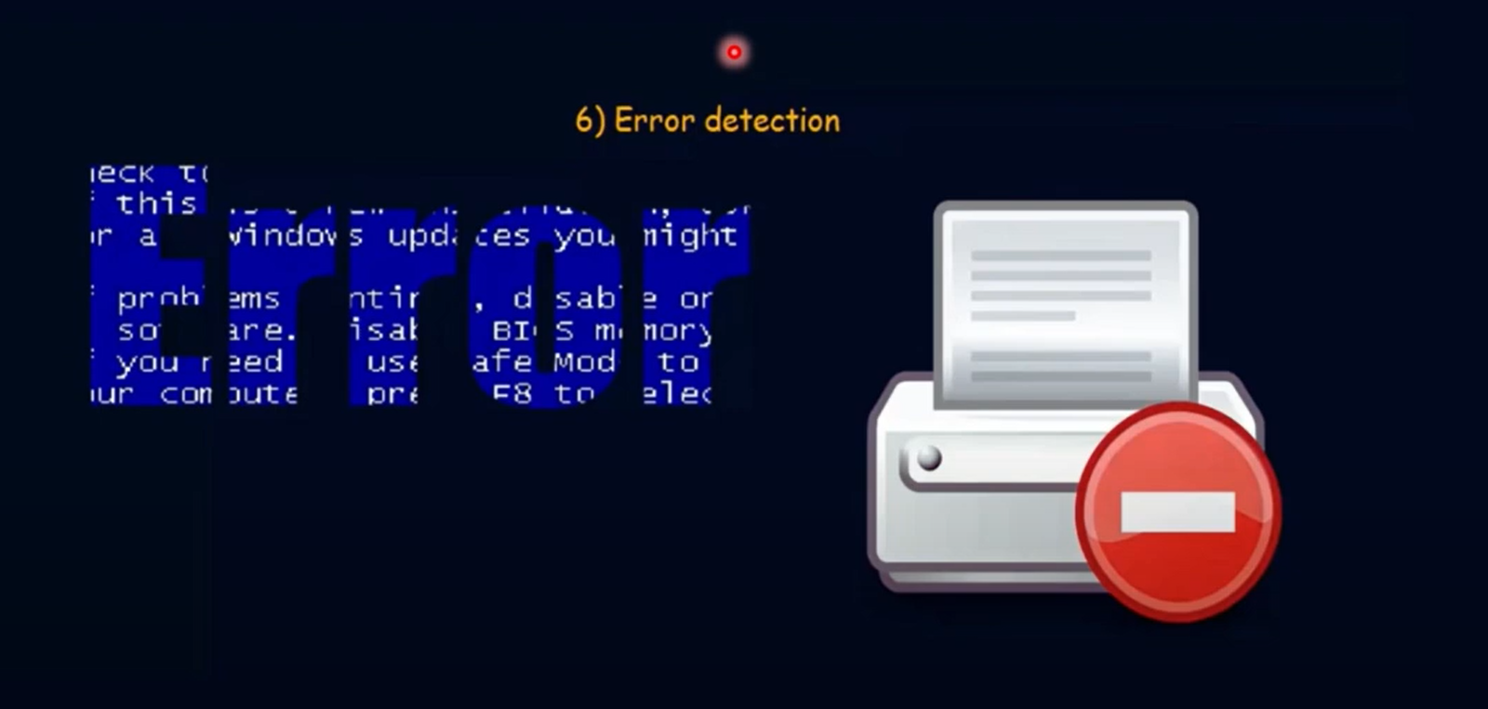

Slide 33


Slide 34


Slide 35


Slide 36
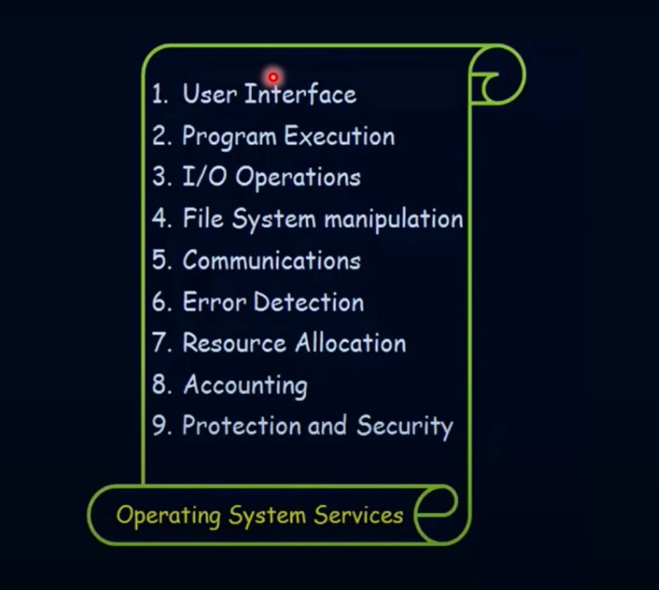

Slide 37
User Operating System Interface

Slide 38
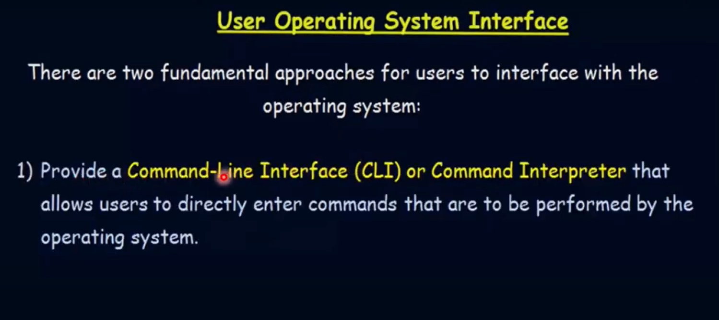

Slide 39
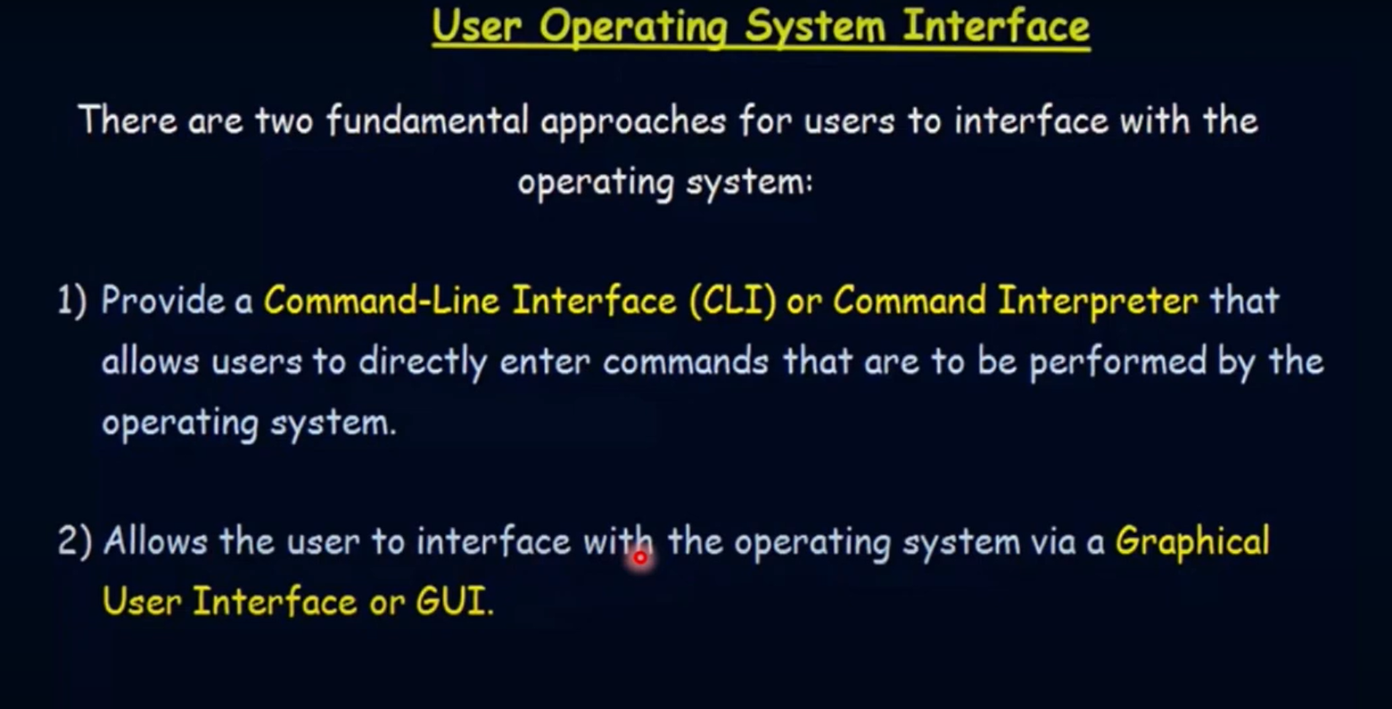

Slide 40
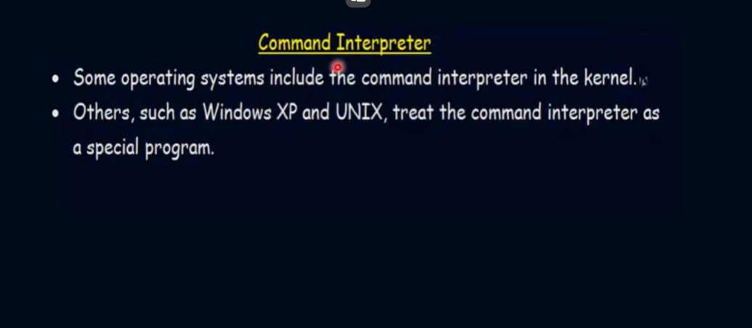

Slide 41
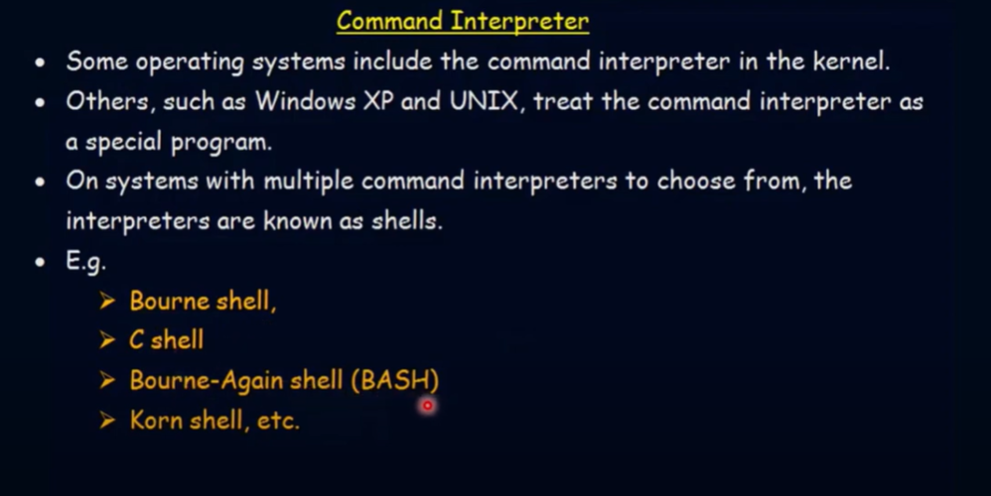

Slide 42
What is System Call

Slide 43
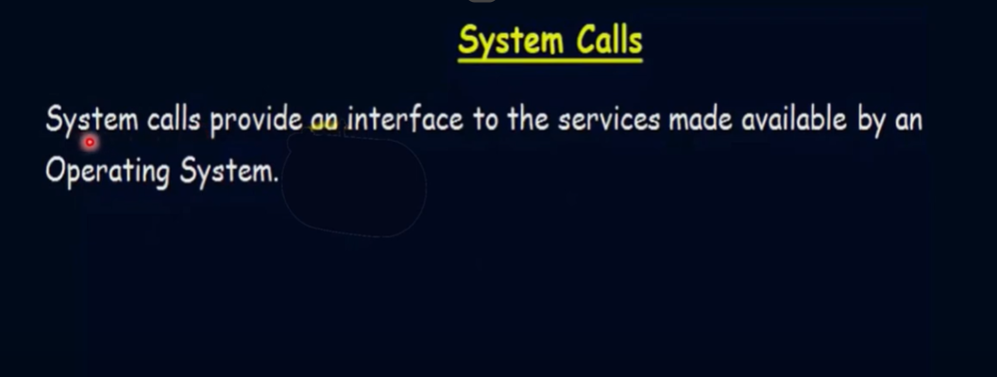

Slide 44
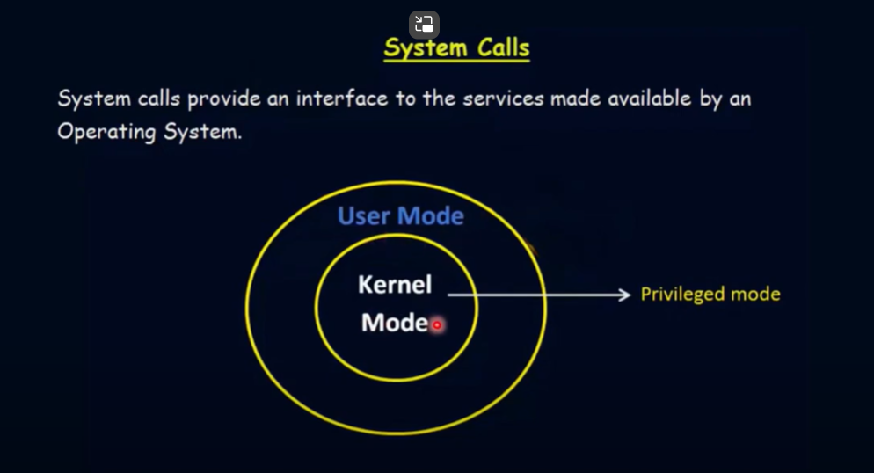

Slide 45
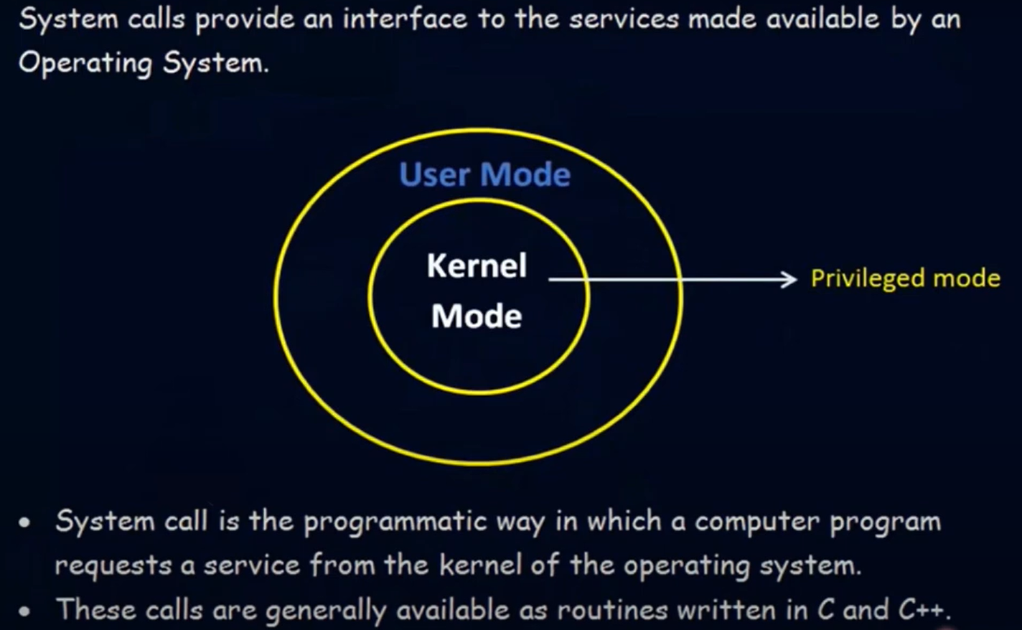
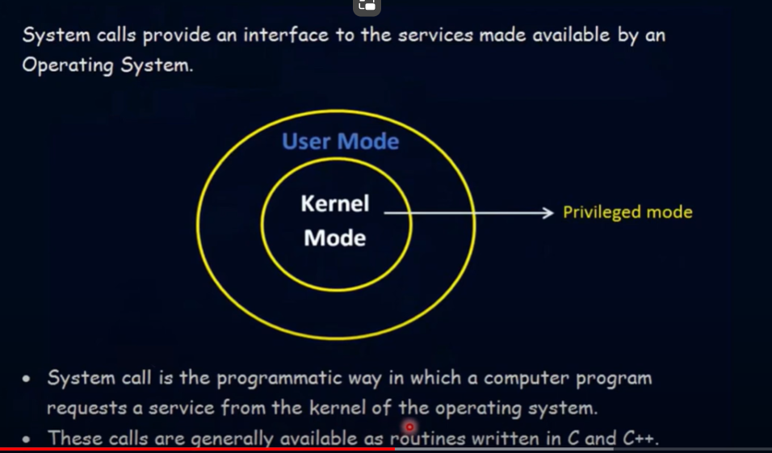

Slide 46
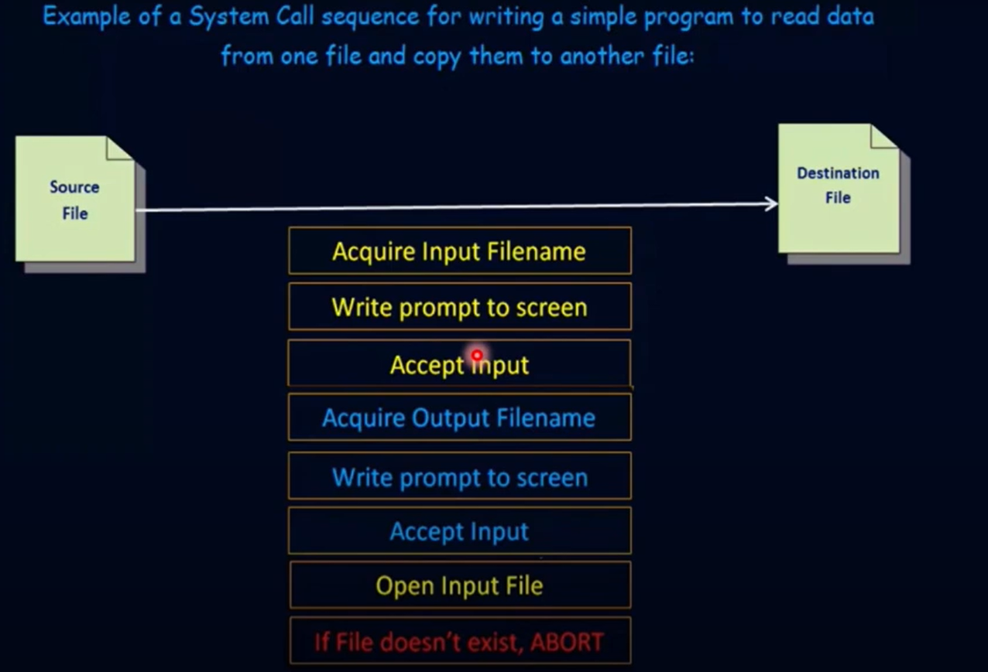

Slide 47
Types of System Call

Slide 48
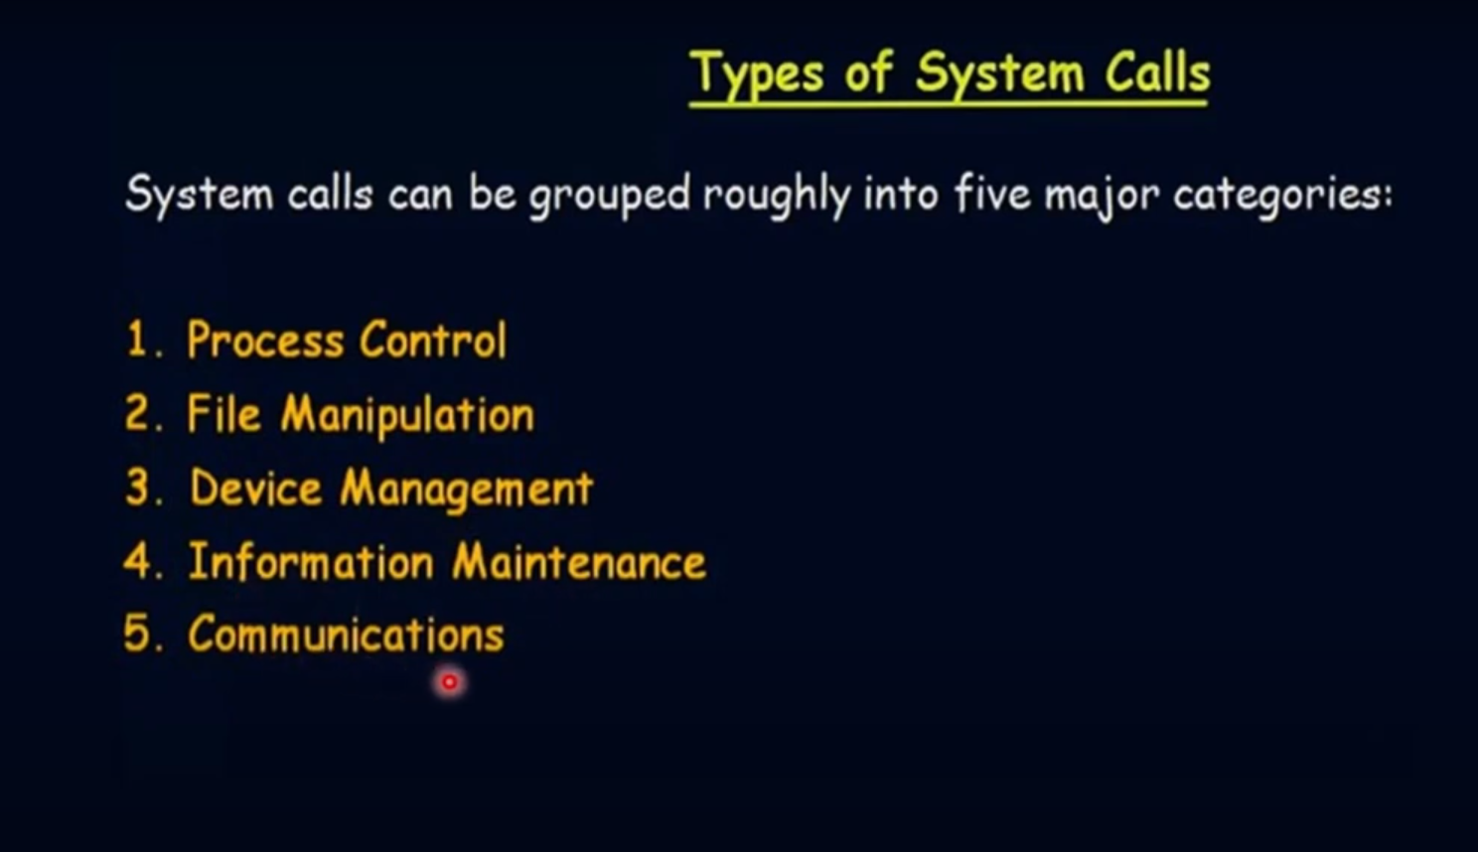

Slide 49
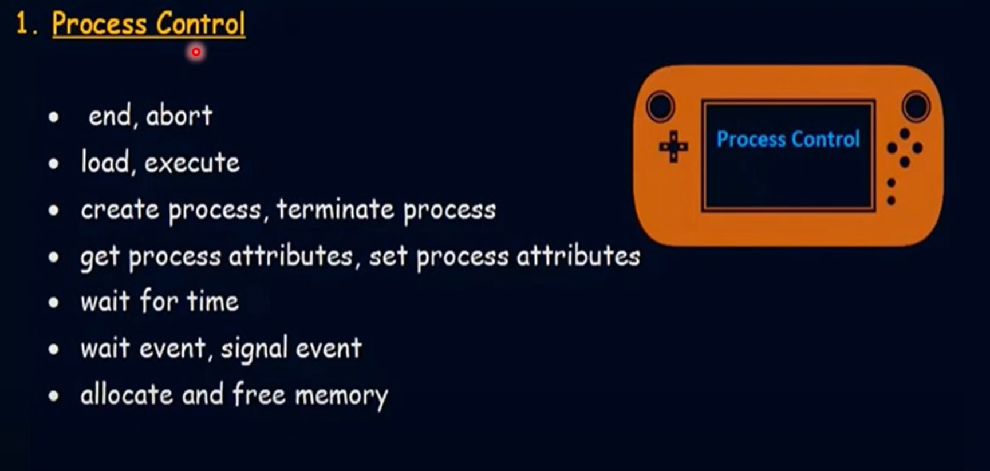

Slide 50
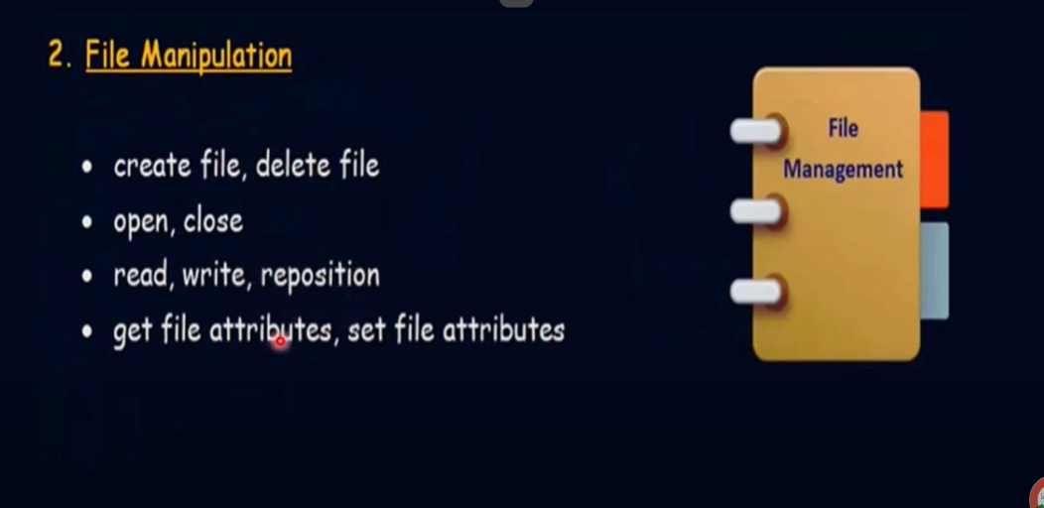

Slide 51
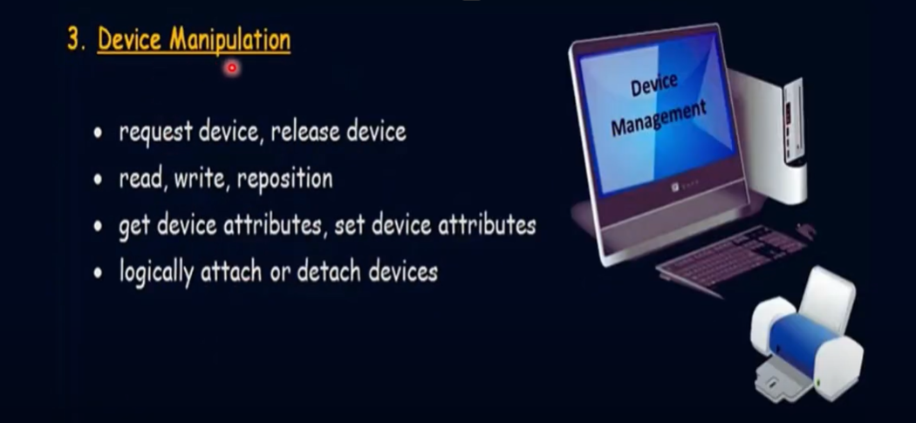

Slide 52
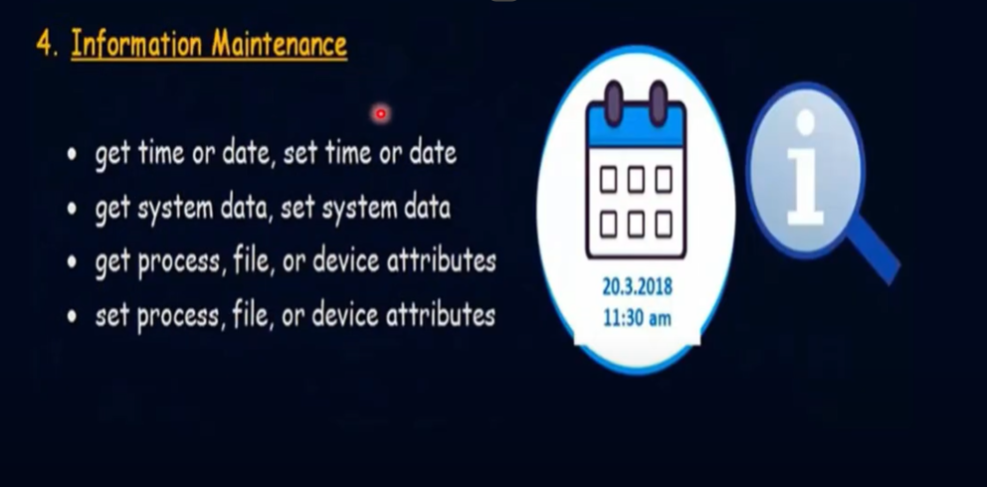

Slide 53


Slide 54
System Programs

Slide 55
MCQ :
1. Which of the following is the fastest type of storage in a computer system?
A. Hard Disk Drive (HDD) B. Cache Memory C. Solid State Drive (SSD) D. Main Memory (RAM)

Slide 56
MCQ
Answer: B. Cache Memory

Slide 57
2. Which storage type is most suitable for long-term, large-scale data storage?
A. Registers B. Cache Memory C. Hard Disk Drive (HDD) D. Main Memory (RAM)

Slide 58
Answer: C. Hard Disk Drive (HDD)

Slide 59
Process and Threads

Slide 60
Program and Process difference
Program
Definition: A program is a static set of instructions written in a programming language to perform a specific task or solve a particular problem. It is essentially a file or a collection of files that contains executable code, along with data and other resources required to execute that code.
State: A program is not active; it's just a set of instructions stored on disk (or another storage medium). It remains inert until it is executed.
Example: A word processor application or a web browser installed on your computer.

Slide 61
Program and Process difference
Process
Definition: A process is a dynamic entity that represents an instance of a program in execution. It is an active state that includes not only the program code but also the current activity, including the program counter, registers, and variables. A process is essentially the execution of a program.
State: A process is active and exists in memory while the program is running. It includes the code, data, and the execution context (e.g., the CPU registers, memory allocation, and execution status).
Example: When you open a word processor, an instance of the word processor program is loaded into memory, and the operating system manages this as a process. If you open multiple documents simultaneously, each document might be handled by a separate process or by threads within a process.

Slide 62
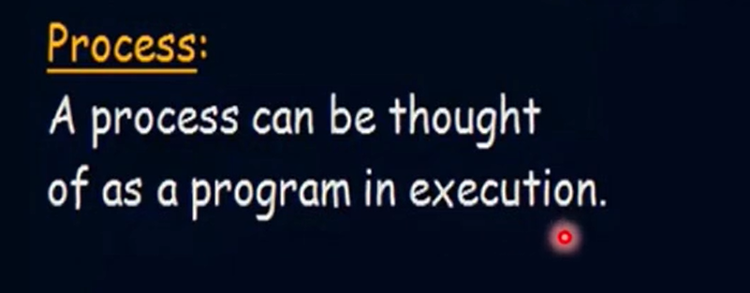

Slide 63


Slide 64
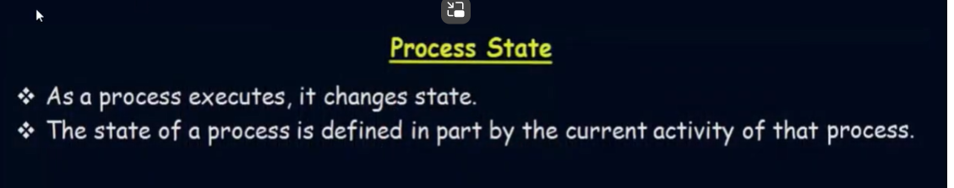

Slide 65
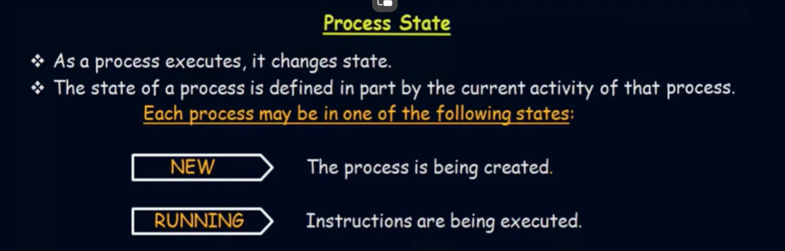

Slide 66
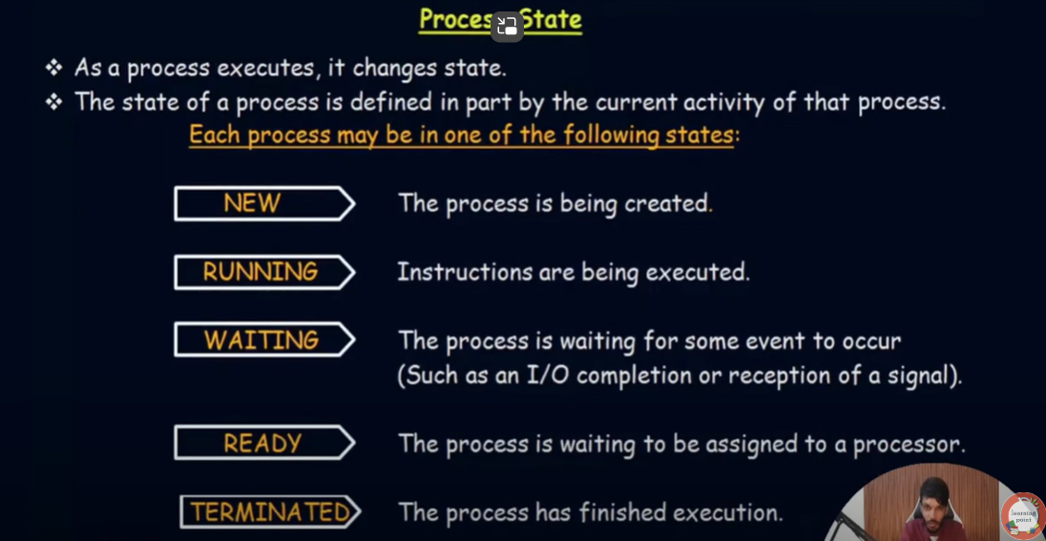


Slide 67
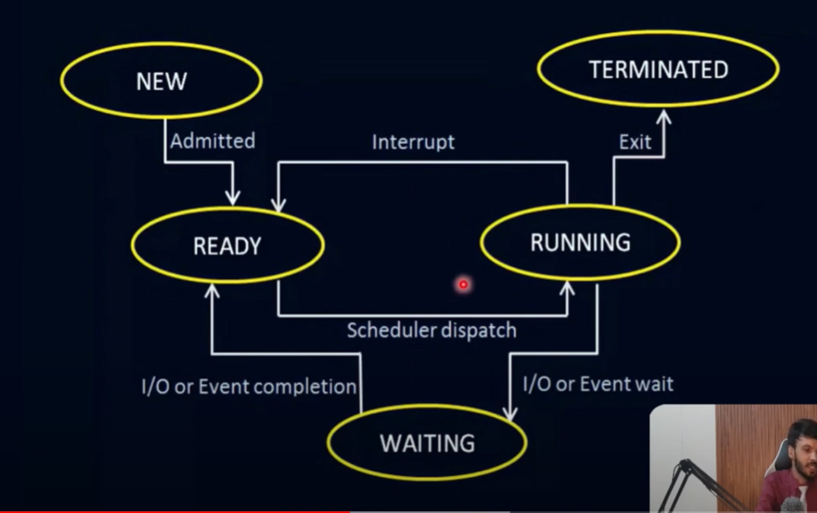

Slide 68
Process Control Block (PCB)
Every process is represented in the operating system by a process control block, which is also called a task control block.
Here, are important components of PCB

Slide 69
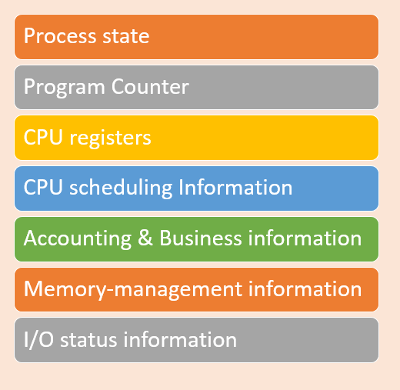
PCB

Slide 70
Process in OS
Process state: A process can be new, ready, running, waiting, etc.
Program counter: The program counter lets you know the address of the next instruction, which should be executed for that process.
CPU registers: This component includes accumulators, index and general-purpose registers, and information of condition code.
CPU scheduling information: This component includes a process priority, pointers for scheduling queues, and various other scheduling parameters.
Accounting and business information: It includes the amount of CPU and time utilities like real time used, job or process numbers, etc.
Memory-management information: This information includes the value of the base and limit registers, the page, or segment tables. This depends on the memory system, which is used by the operating system.
I/O status information: This block includes a list of open files, the list of I/O devices that are allocated to the process, etc.

Slide 71
Process in OS
Summary
A process is defined as the execution of a program that performs the actions specified in that program.
Process management involves various tasks like creation, scheduling, termination of processes, and a dead lock.
The important elements of Process architecture are 1)Stack 2) Heap 3) Data, and 4) Text
The PCB is a full form of Process Control Block. It is a data structure that is maintained by the Operating System for every process
A process state is a condition of the process at a specific instant of time.
Every process is represented in the operating system by a process control block, which is also called a task control block.

